Slide 1
TALASH
Talent Acquisition & Learning
Automation for Smart Hiring
Milestone 2: Core Extraction, Analysis Pipeline & Intermediate Web App
CS 417 – Large Language Models | Spring 2026
BSDS-2023 · SEECS, NUST
Mehreen Raheel · Eeshal Tahir · Huma Ejaz
Instructor: Prof. Dr. Muhammad Moazam Fraz
MILESTONE 2
1

Slide 2
Milestone 2 Scope: From Parsing to Analysis
MILESTONE 2
What changed after Milestone 1
Folder mode
Gemini first
5 modules
7 tabs
CV ingestion + batch processing
LLM-assisted extraction
Analysis modules active
Interactive web app
Milestone 1 foundation
Milestone 2 upgrade
• PDF reading with pdfplumber
• Education, experience, research analysis
• Section-aware regex parsing
• Missing info detection + email drafts
• Early Streamlit prototype
• Candidate summaries with suitability labels
• JSON output schema
• Comparison table + radar visualization
2

Slide 3
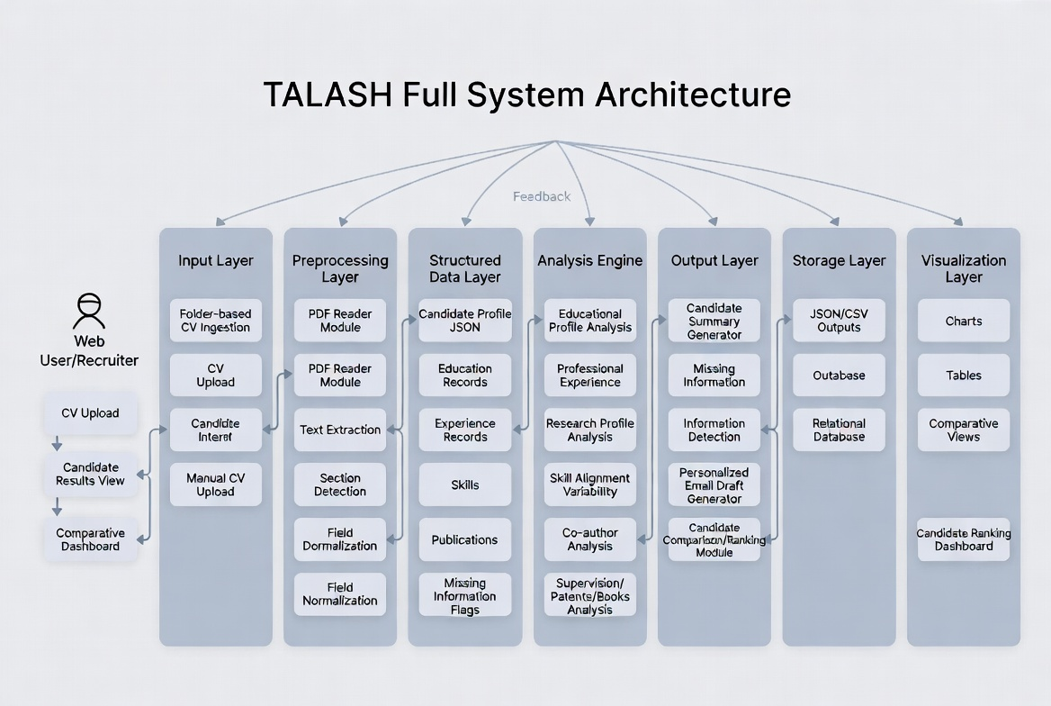
Updated System Architecture
MILESTONE 2
Milestone 2 expands the analysis and presentation layers
What’s new in the architecture
• LLM-first parser with regex fallback
• Analysis layer now includes education, experience, research, missing info, and summary modules
• Streamlit rebuilt into a multi-tab dashboard
• Session-state processing enables candidate comparison
3

Slide 4
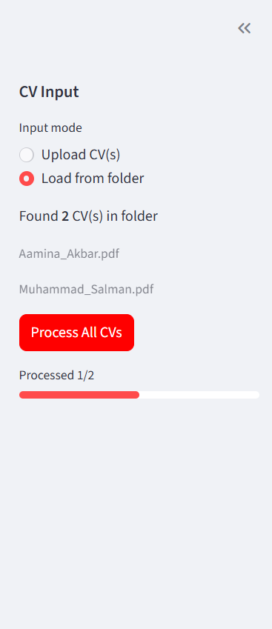
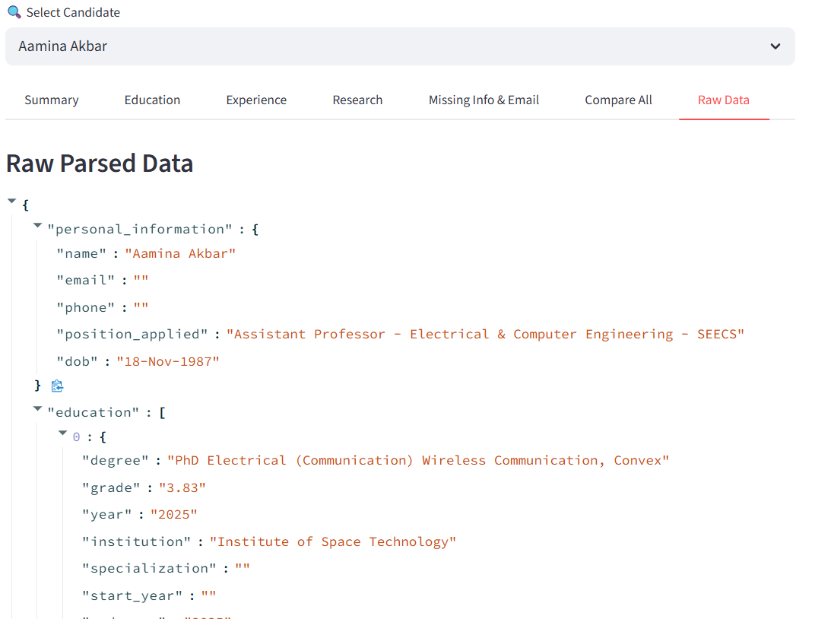
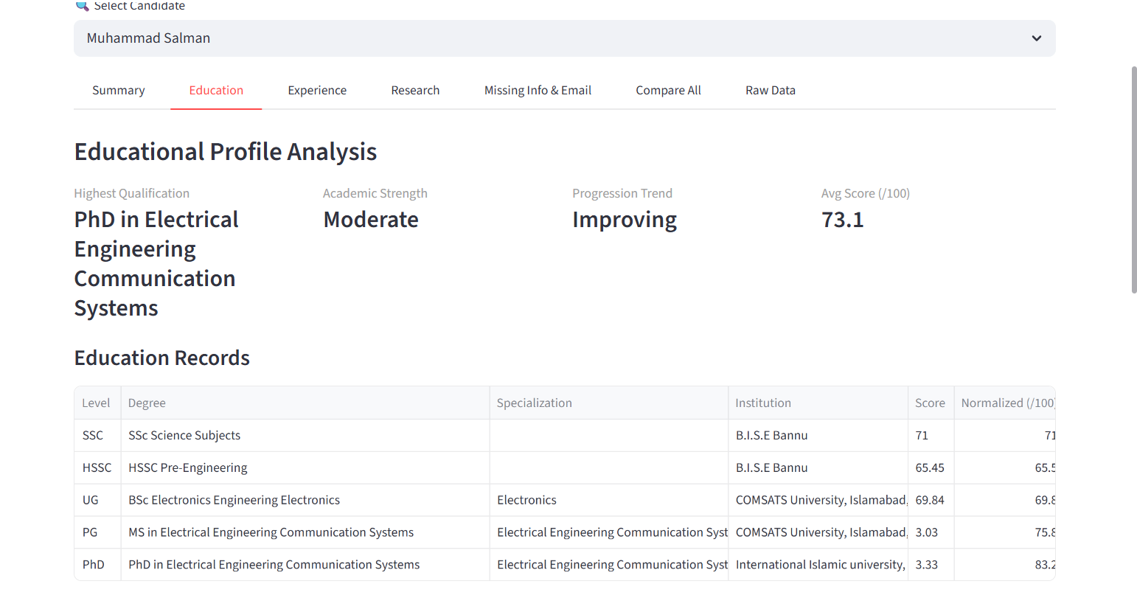
Core Extraction Pipeline
MILESTONE 2
Batch CV ingestion + structured LLM JSON extraction
1
Input CVs
2
Extract text
3
Gemini JSON
4
Regex fallback
5
Analysis dicts
6
Streamlit UI
Extended schema now includes supervision, books, patents, skills and parsed research fields in addition to personal info, education, experience and publications.
4

Slide 5
Active Analysis Modules
MILESTONE 2
Five analysis modules are now functional in Milestone 2
education_analysis.py
CGPA normalization, level classification, gap detection, institution quality, academic strength
experience_analysis.py
Timeline normalization, gap/overlap detection, career progression scoring
research_analysis.py
Publication counts, journal vs conference classification, impact factors, themes
email_drafter.py
Missing/incomplete/unclear detection plus personalized follow-up email
summary_generator.py
Suitability label and LLM-enhanced narrative candidate summary
Shared utility: normalizers.py handles CGPA scale detection, education level classification, specialization extraction and safe numeric parsing.
5

Slide 6
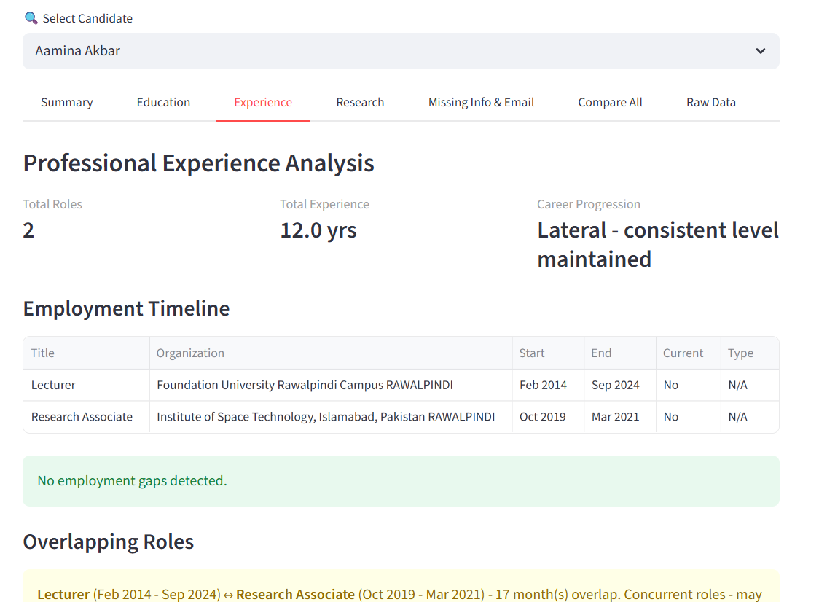
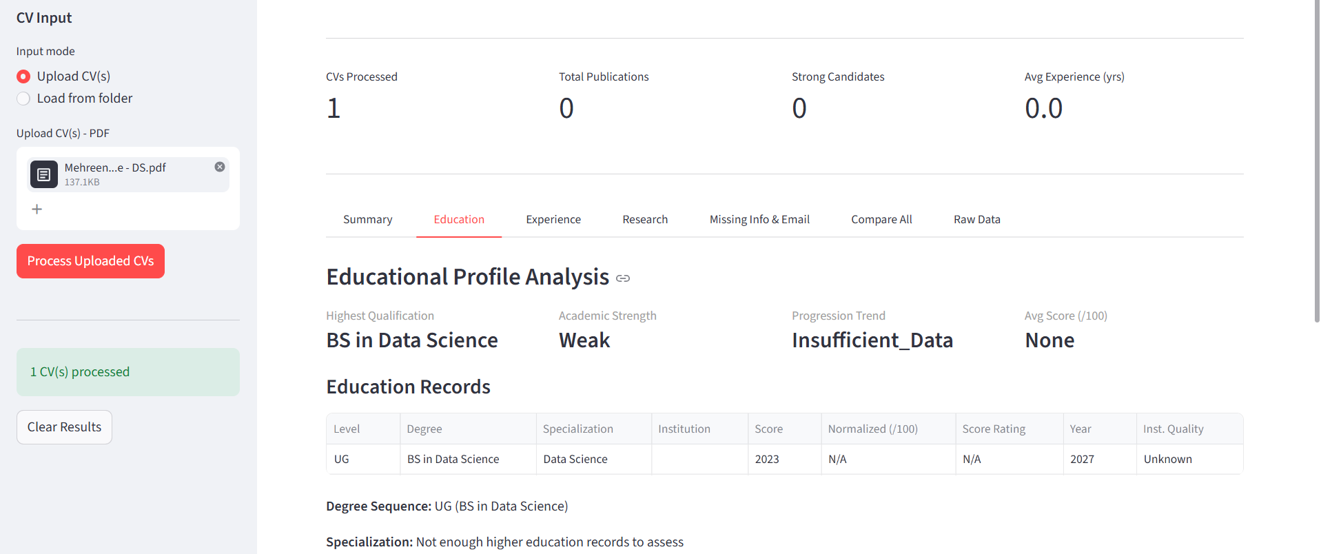
Educational Profile Analysis
MILESTONE 2
Normalized scores, degree progression, gaps and institution quality
• Converts CGPA/percentage/letter grades into a common 0–100 scale while preserving original values
• Classifies education levels from SSC → HSSC → UG → PG → PhD and flags unusual gaps
• Uses a curated institution tier database for quick quality assessment
6

Slide 7
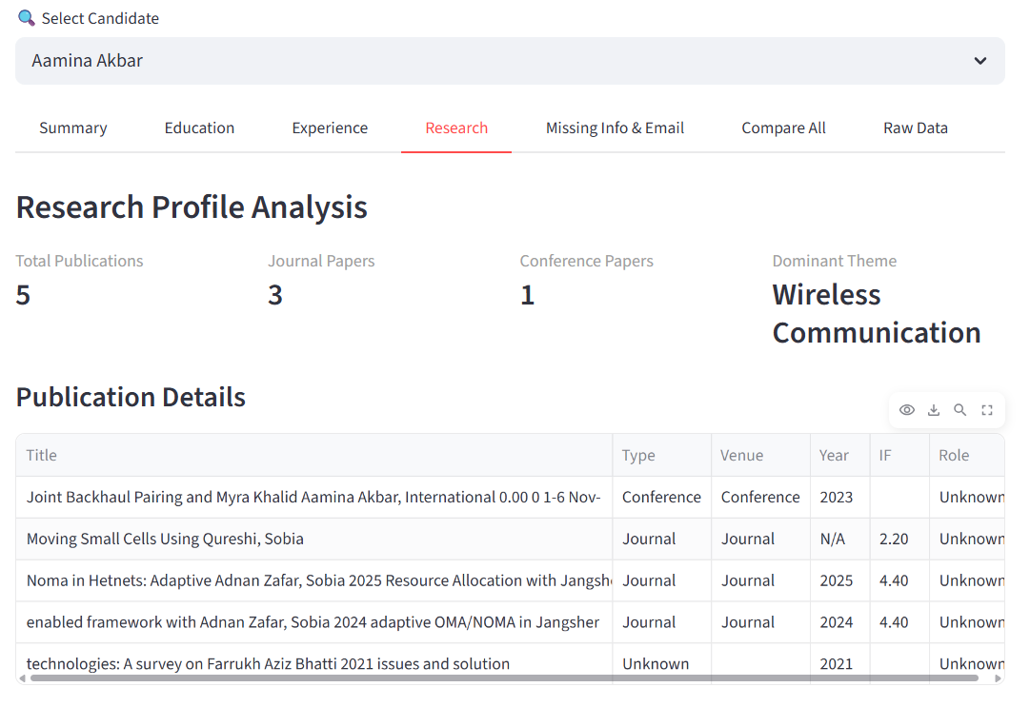
Professional Experience Analysis
MILESTONE 2
Employment continuity, overlaps, gaps and seniority progression
Timeline checks implemented
• Normalizes dates from strings like “Feb-2014 – Sep-2024” and “Present”
• Flags employment gaps over 90 days
• Classifies gaps as minor, moderate, or significant
• Detects overlapping roles and separates short transitions from concurrent roles
• Scores career progression using title seniority lookup
7

Slide 8
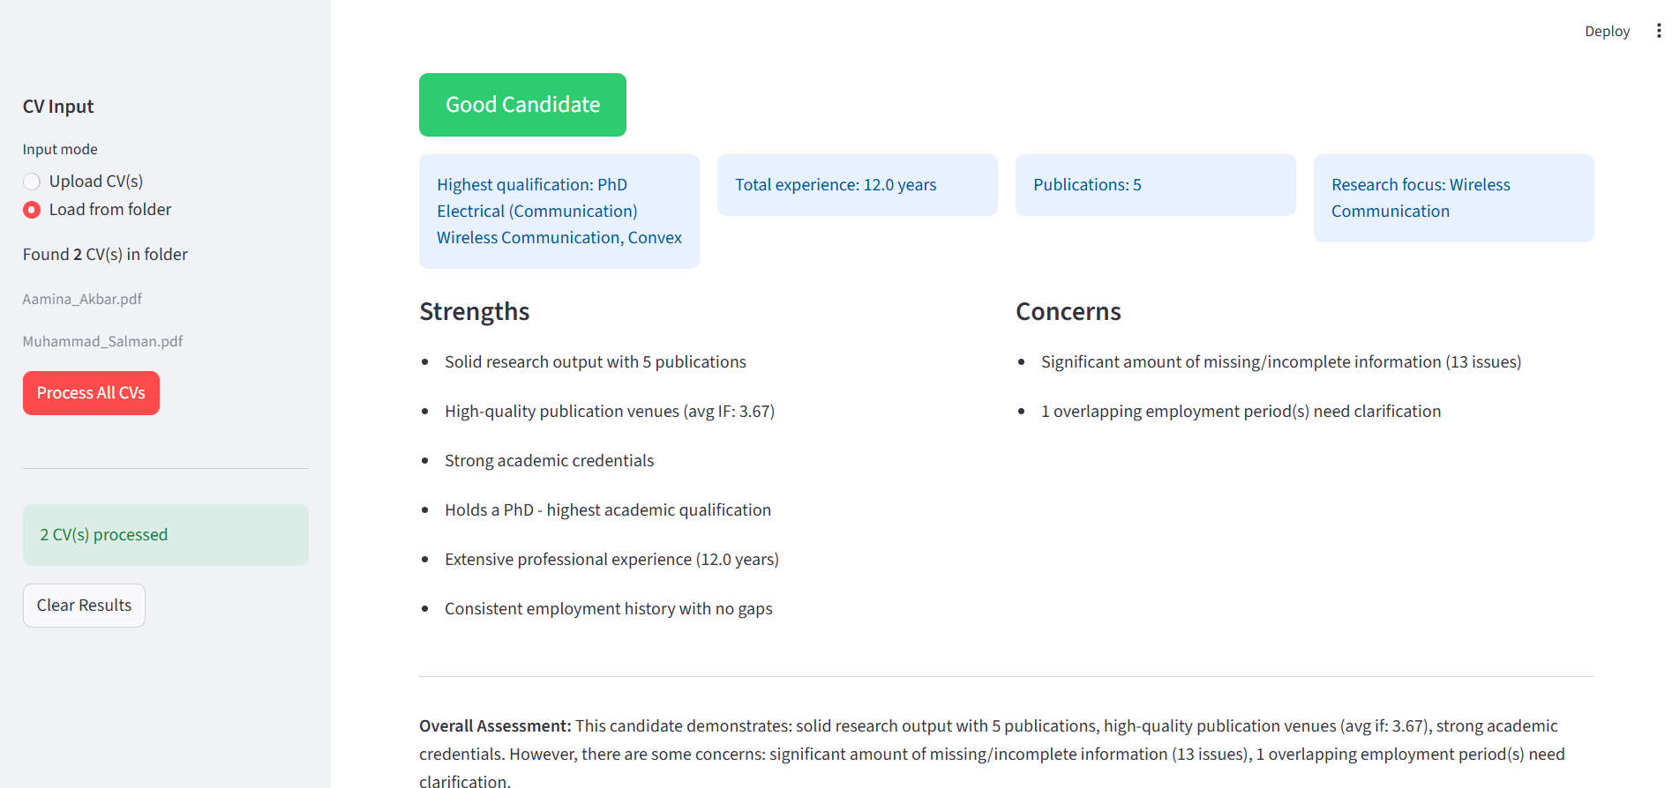
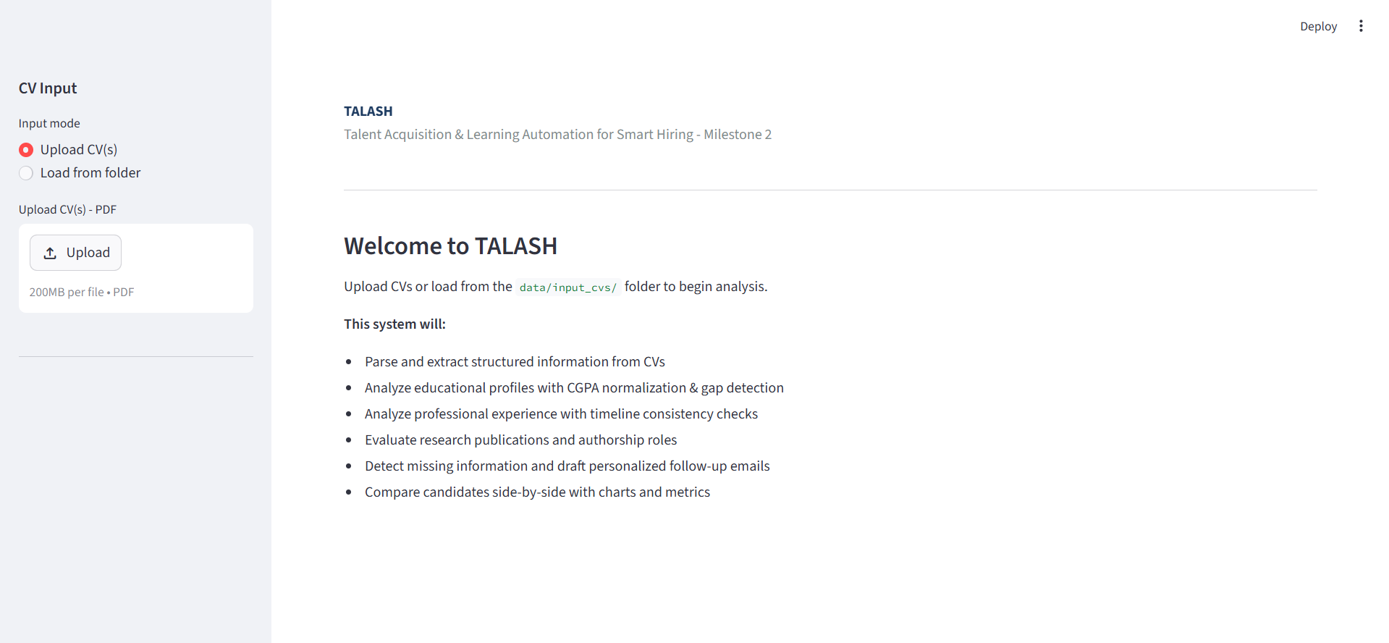
Research Profile Processing
MILESTONE 2
Partial research analysis delivered for Milestone 2
• Counts total publications and breaks them down into journal, conference and other categories
• Extracts impact factors, top venues, year-wise publication timeline and dominant themes
• Advanced WoS/Scopus verification, quartile ranking and co-author network analysis are planned for Milestone 3
8

Slide 9
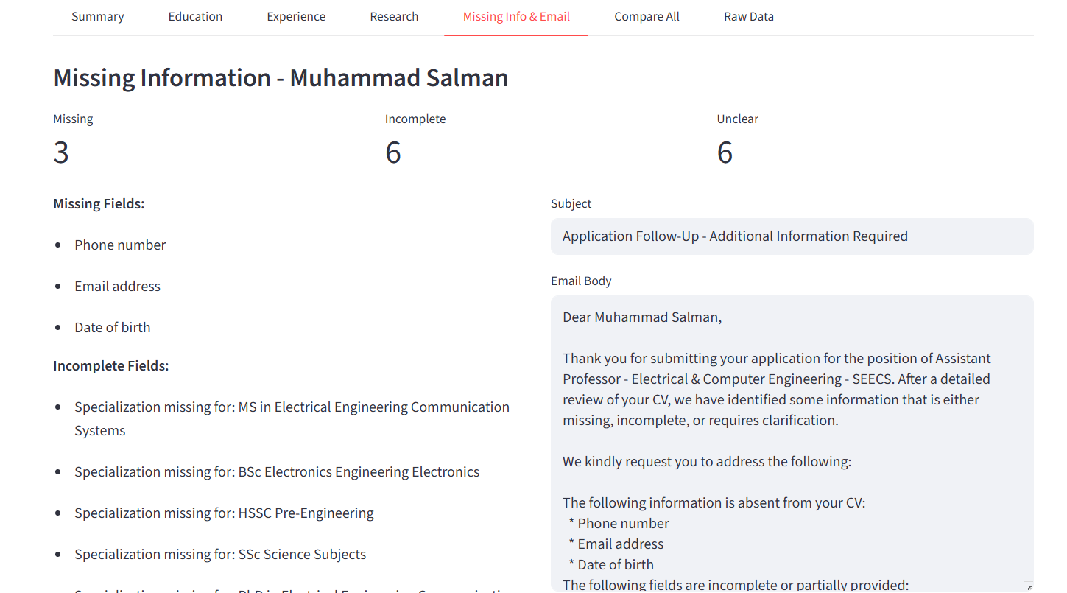
Missing Information + Personalized Email Drafting
MILESTONE 2
Three-tier issue classification with candidate-specific follow-up
Missing
Field absent entirely
Incomplete
Sub-fields missing
Unclear
Value ambiguous
Sample generated email
Subject: Application Follow-Up - Additional Information Required
Dear Muhammad Salman,
Thank you for submitting your application. After reviewing your CV, we found information that is missing, incomplete, or requires clarification.
Please share your phone number, email address, date of birth, and missing degree specializations.
9

Slide 10
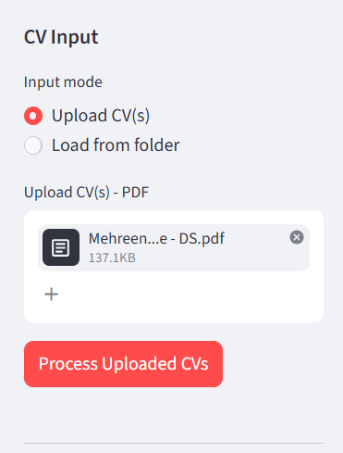
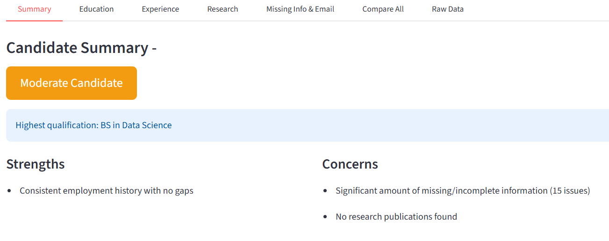
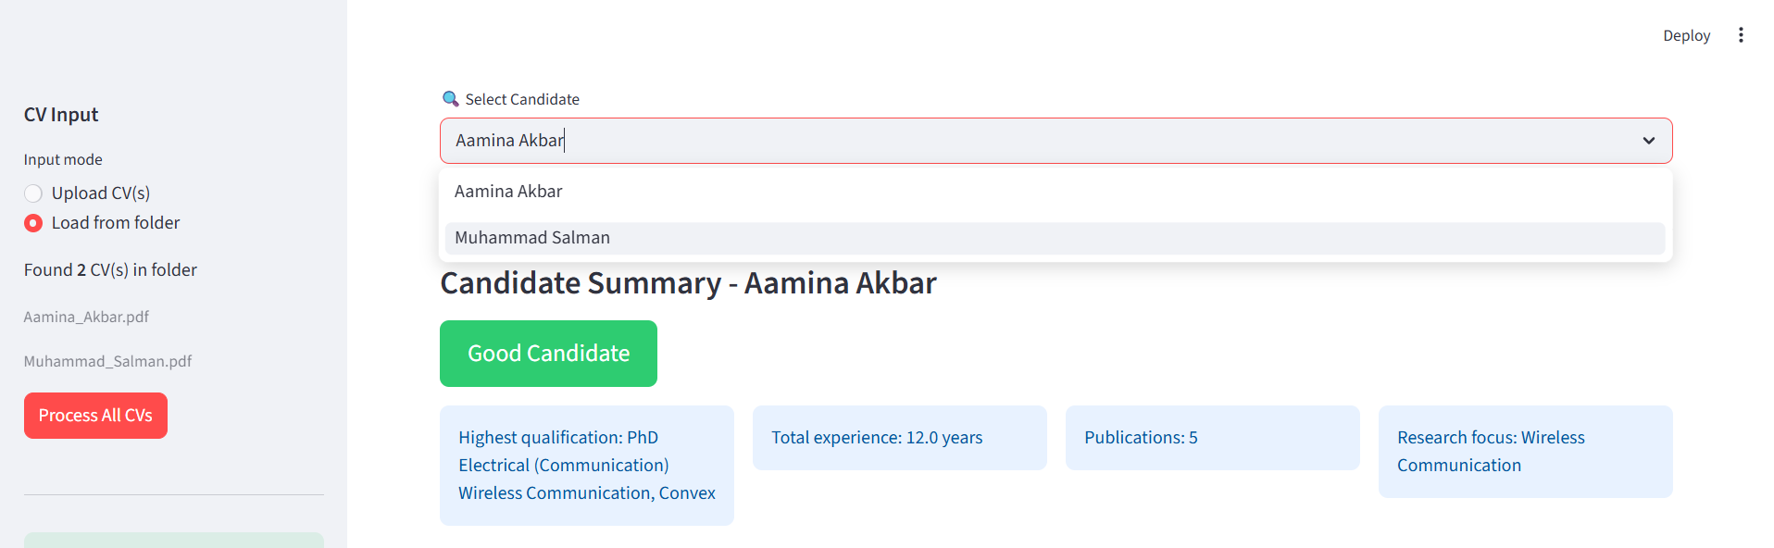
Candidate Summary Generation
MILESTONE 2
Suitability label + narrative summary for recruiter review
Weighted label inputs
• Academic strength from education analysis
• Total years of experience from timeline analysis
• Research output from publication analysis
10

Slide 11
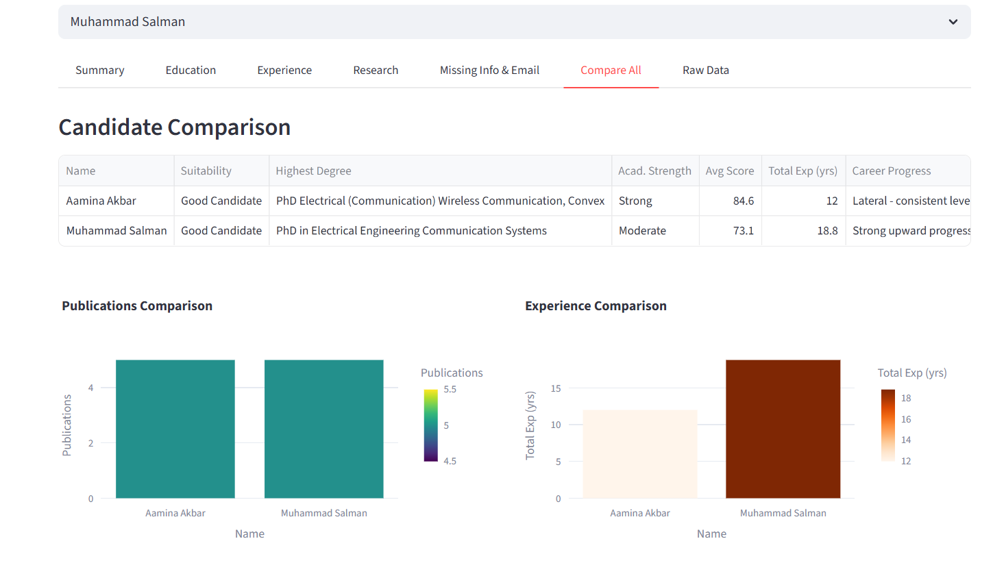
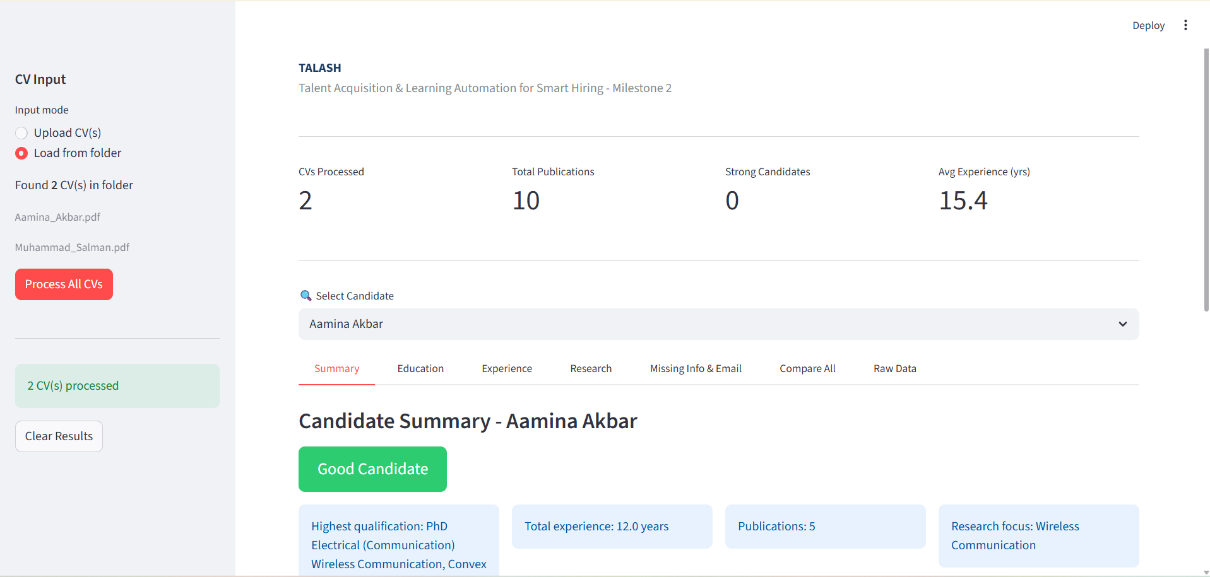
Intermediate Streamlit Web App
MILESTONE 2
7-tab dashboard with upload mode, folder mode, selector and comparison
• Tabs: Summary, Education, Experience, Research, Missing Info & Email, Raw Data, Compare All
• Dashboard metrics: total CVs processed, total publications, strong candidates, average experience
• Candidate selector supports multi-CV analysis without re-running the pipeline
11

Slide 12
Technologies & Libraries
MILESTONE 2
Core tools used in the Milestone 2 implementation
Technology
Version / Model
Purpose
Python
3.14
Primary programming language
Streamlit
>= 1.33.0
7-tab interactive web application
Google Gemini API
gemini-2.0-flash
LLM parsing and summary generation
pdfplumber
>= 0.11.0
Layout-aware PDF text extraction
Plotly
Latest
Interactive bar, pie and radar charts
pandas
>= 2.2.0
Tabular outputs and candidate comparison
python-dateutil
>= 2.9.0
Employment timeline date parsing
Git / GitHub
-
Version control and collaboration
The stack supports both reliable rule-based fallback and LLM-enhanced extraction, keeping the pipeline usable even when the Gemini API is unavailable.
12

Slide 13
Milestone 2 Completion Status
MILESTONE 2
Delivered items mapped to the rubric
Deliverable
Status
LLM + regex structured extraction
Complete
Folder-based batch CV ingestion
Complete
Education analysis: normalization, gaps, institution quality
Complete
Experience analysis: timeline, gaps, overlaps, progression
Complete
Missing info detection + personalized emails
Complete
Summary generation + suitability labels
Complete
Partial research profile processing + charts
Complete
Advanced research/ranking modules
Milestone 3
Result: a functioning end-to-end analysis pipeline, not just a parser prototype.
13

Slide 14
Limitations & Milestone 3 Roadmap
MILESTONE 2
What remains before the final system
Current limitations
Planned for Milestone 3
• Static institution quality database
• WoS/Scopus indexing and Q1–Q4 verification
• Portal PDFs omit email/phone fields
• CORE conference ranking and authorship roles
• Publication extraction still affected by table layout
• Supervision, books and patents analysis
• Research analysis is still partial
• Weighted candidate ranking + skill alignment
TALASH — Smart HR Recruitment System | github.com/mehreennwhyn0t/Talash
14

